Slide 1
Instruction for Ushers
Our Savior’s Lutheran Church
New Ulm, MN

Slide 2
Before Worship Please arrive at least 30 minutes before the service. When you arrive: BULLETINS should be on the tables near the stained glass double doors. Please place bulletins near each door into the sanctuary. Check that offering plates are on the bottom shelf of the ushers’ table at the back of the sanctuary.

Slide 3
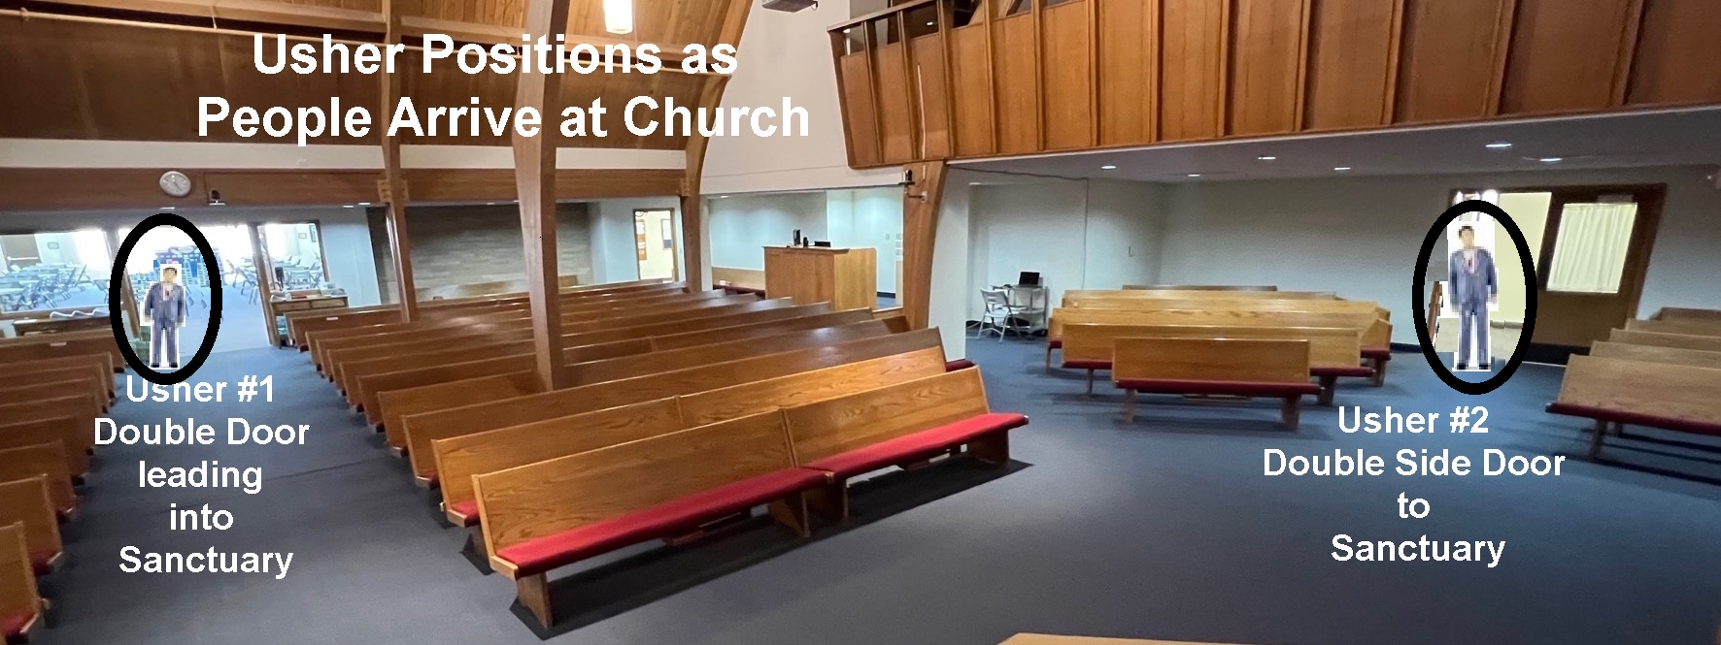
Before Worship
Usher Positions as People Arrive at Church

Slide 4
As the Worship Service Begins – During Worship
CLOSE THE DOORS to the sanctuary after the Pastor and acolytes move in for the Processional.
During the “Gathering Hymn” COUNT the number of persons present – including all children and persons in the choir and the balcony and record that number on the attendance sheet in the ushers’ binder.

Slide 5
The Offering

Slide 6
The Offering
Ushers gather with the acolytes at the stained glass doors after the “Hymn of the Day” and the “Apostles Creed”

Slide 7
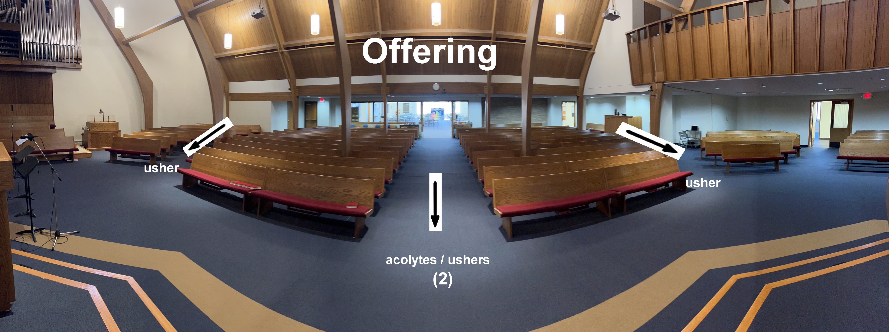
After the “Sharing of God’s Peace”, the acolytes will move to the front of the Sanctuary in the center aisle, while the ushers move to the side aisles.

Slide 8
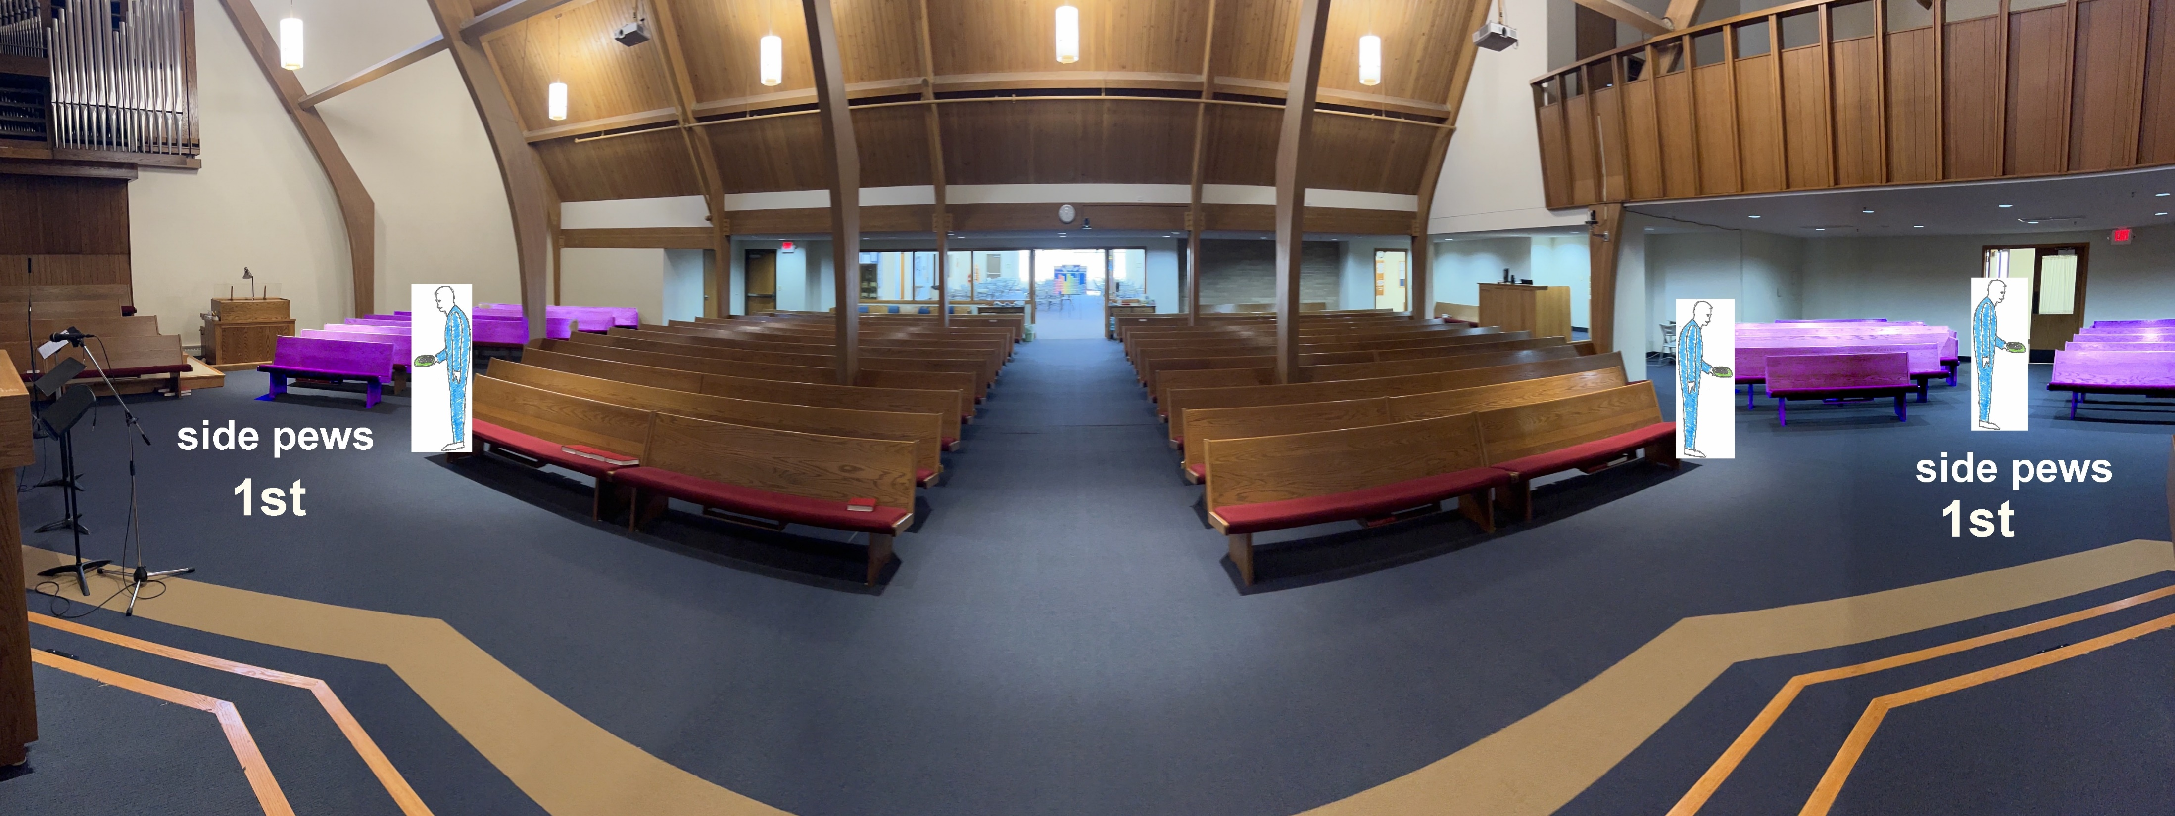
The Offering
Starting at the front of the congregation, the ushers will pass the offering plates:
FIRST to the side pew sections … and

Slide 9
The Offering
When side pew sections are completed the ushers will move to the outside side aisles to assist the acolytes with the passing of the offering plates in the center pew sections.

Slide 10
Special Instructions for Noisy Offering
Before Worship confirm that the four metal “Noisy Offering” Buckets are under the ushers’ table. These buckets are used to collect change, cash or other gifts.
RECEIVE THIS OFFERING according to the procedure just described above.
In addition to passing the offering plates (and following at least a few rows behind) pass the noisy offering buckets. It is ideal if another set of ushers or other representatives (e.g. Mission Board) pass these buckets.
If you do not have additional ushers, pass the buckets after passing the plates has been completed

Slide 11
The Offering
Once the collection is done and all the offering plates have reached the rear of the Sanctuary the ushers will be consolidate them and prepare to bring the offering plates forward to the altar.
(Note: the “Noisy Offering” pails that Have been passed should remain at the rear of the Sanctuary.)

Slide 12
Holy Communion

Slide 13
Holy Communion
During the “Offertory Song” bring the gifts forward up the center aisle and give the Communion elements to the pastor at the steps in front of the altar
One usher will bring up the wine and the other will bring up the bread/wafers
The acolytes will bring up the offering plates

Slide 15
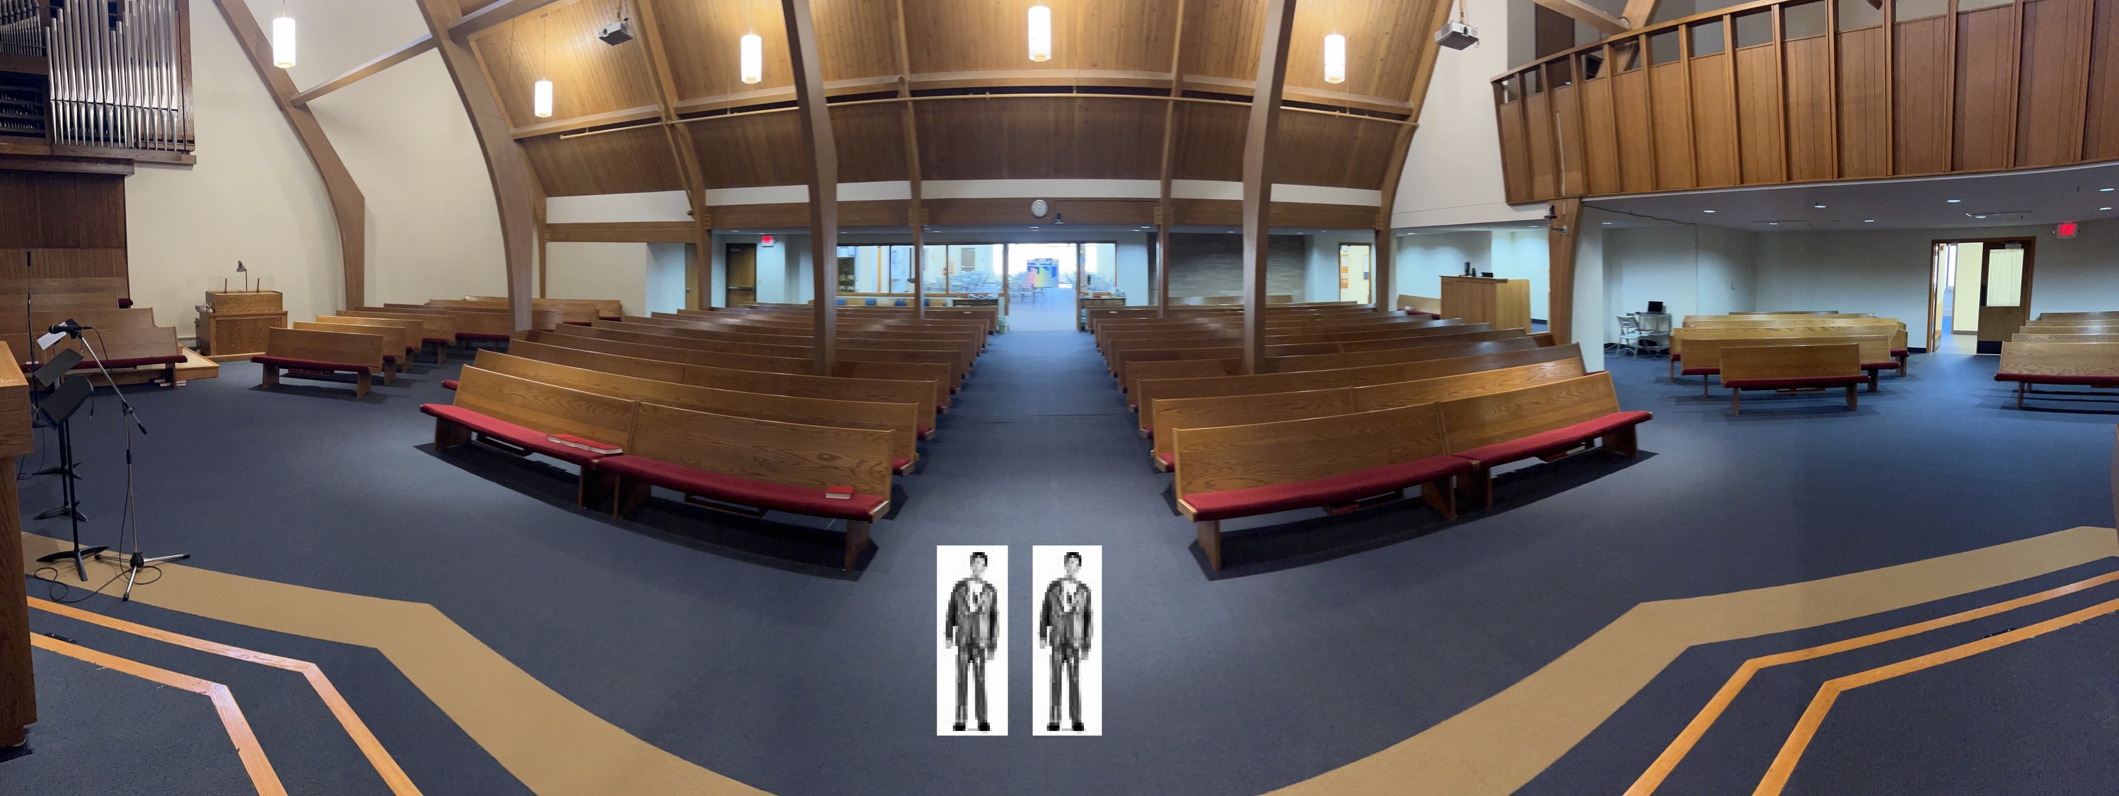
Holy Communion
Ushers remain stranding in front of the altar until after the “Offertory Prayer”
Ushers return to the stained glass doors at back of Sanctuary during the “Words of Institution”

Slide 16
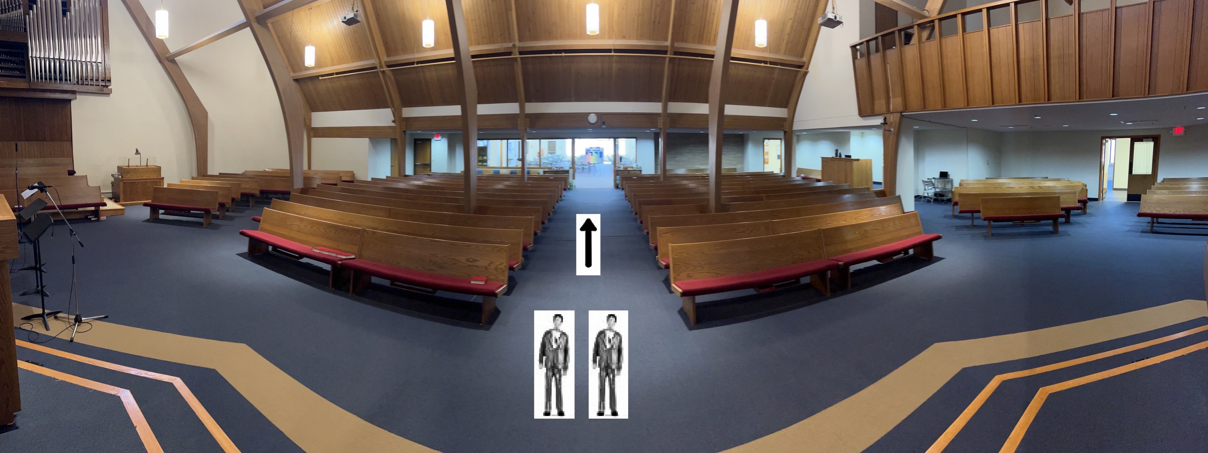
Ushers return to the stained glass doors at back of Sanctuary during the “Words of Institution”

Slide 17
Holy Communion – 2 stations
USHERS DISMISS congregants from their pews to approach the Altar
Starting at the front, dismiss the large pew sections first via the CENTER AISLE

Slide 18
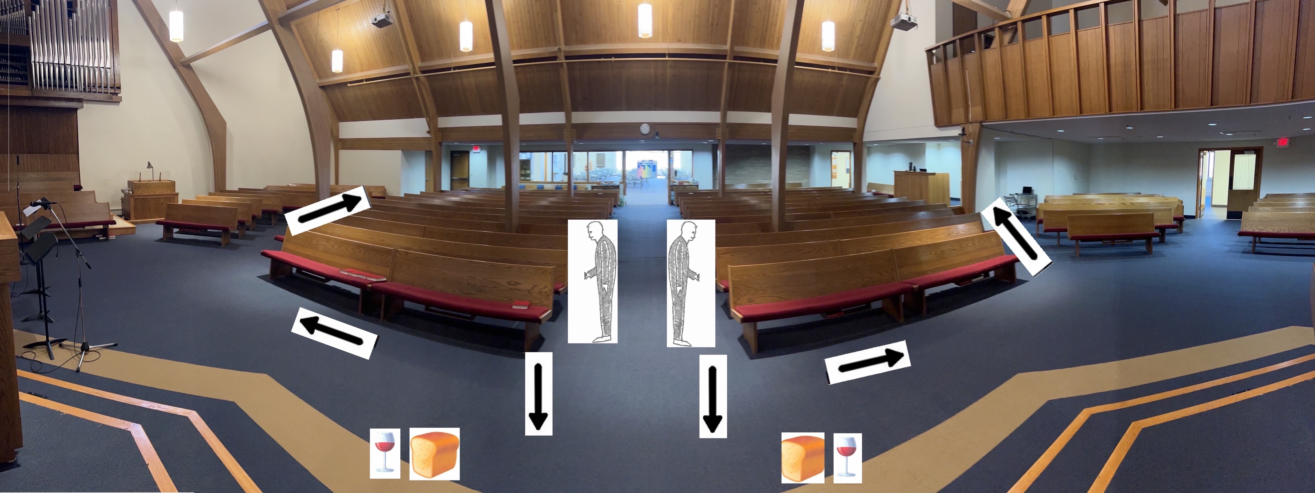
Holy Communion – 2 stations
Communicants proceed to nearest communion station and return to their pews via the outside aisles

Slide 19
After dismissing from the large sections, dismiss the small pew sections.

Slide 20
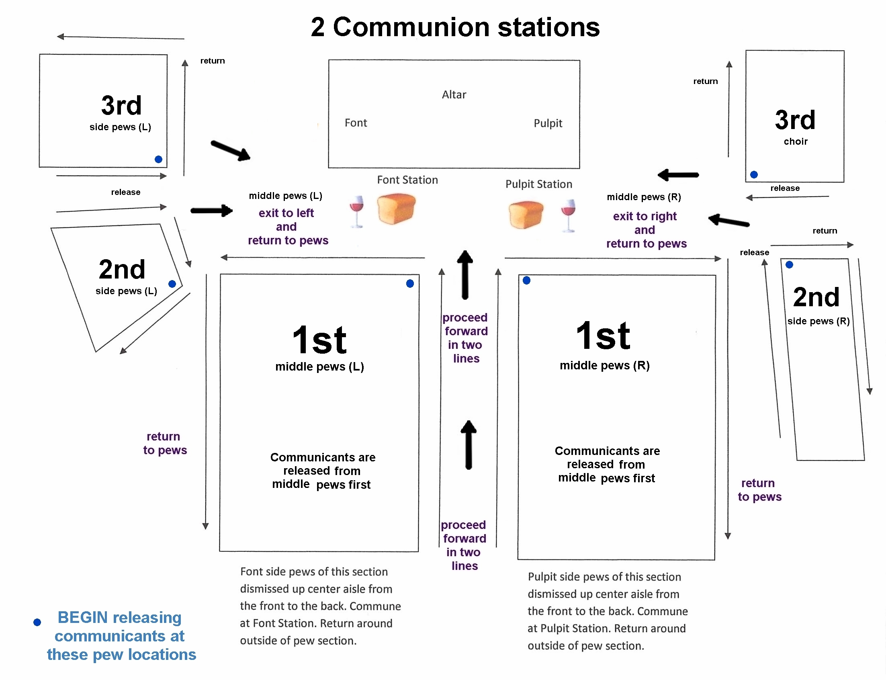

Slide 21
WATCH FOR congregants that cannot leave their pews to commune and ask them if they would like communion brought to them where they sit and tell Pastors when you commune. Ushers commune at the end of the line.

Slide 22
Following the Worship Service
COLLECT THE OFFERING PLATES AND PLACE THEM ON THE ALTAR
SHELVE & STRAIGHTEN HYMNALS
GATHER BULLETINS for Re-Use or Recycling
PICK UP trash or other items left in the sanctuary
CLEAN AROUND THE ALTAR with the small carpet sweeper from the sacristy

Slide 23
Thank you for your interest in Ushering

